Slide 1
Knowledge Planet Library
Library Membership Control System

Slide 2
Library’s background
Knowledge Planet Library is a library of “Knowledge Planet Academy”, a private learning center founded in the year 2004 and is located in Yangon, Myanmar. The library was officially opened in the year 2005 for the purpose of getting more references, knowledge and information for the students of this school. The library was rather a small one when it was founded. Now, over the past 9 years, the size of the library is getting bigger because the library’s officials have been buying many new kinds of books to become a better library and the students’ knowledge center point. And the increasing number of members makes the staffs difficult to handle the records manually.

Slide 3
Current system
Since the library was founded, the staffs have been doing all the works manually. That is, the librarians have to record everyday transactions manually on the paper- based system. He or she has to write down every detail in the books daily. It’s really a time consuming task and data inconsistency is also very high. Below are the problems that current system is facing with.

Slide 4
Problems background
Slow Retrieval of Data - The information is stored in different parts of the site and it may take a long time to retrieve or update the data. Sometimes, it can take up to 20 or 30 minutes finding the relevant information.
Paper Wastage - Much paper is waste due to the number of records daily and number of library members. Duplication of data can be occurred by repeating the same thing over and over.
Unproductive use of storage space - Paper takes up a massive amount of room in the site.
Poor Customer Service - Sometimes, the information needed may be unavailable.
No reliable database system - The records on paper can be lost or damaged at any time. Since there is no backup for the data, the lost or damaged documents cannot be regained at all.
No security system – Writing on paper is totally lack of security system. Any unauthorized person may view, update or even the data can be stolen.
These are the weak points that the current system is facing with.

Slide 5
Objectives
The main purpose of the new system is to handle all the problems that the old system is currently facing with. With the newly implemented system, the records can be easily created. There will be no duplication of data records because all the data records are controlled by a record key called ID. There is also an error checking method to detect the data type error (e.g. the record cannot be stored if the user types the alphabet character where a numeric value must be typed in). For retrieval of the records, it is much faster and easier than the previous system. Editing and deleting also can be easily and quickly performed. The records are to be stored in the security enabled database system which can store many lines of data records. There will be no store room at all to store the documents and no paper wastage at all. So, all the current problems will be solved with this single “Library Membership Control System”. The staff will only need to sit at the workstation just to perform all these tasks.
These are the advantages of the new “Library Membership Control System”.

Slide 6
File Specification
No. | Item Name | Description | Data Type | Size | Range
1 | mem_id | Member ID | char | 4 | 0-9999
2 | name | Name | char | 20 | a-z/A-Z
3 | ic_no | IC_No. | char | 10 | A-Z/9999999
4 | gender | Gender | char | 1 | M/F
5 | phone | Phone | char | 10 | 0-9999999
6 | addr | Address | char | 30 | a-z/A-Z/0-999999999
7 | reg_date | Registration Date | char | 10 | 12/12/9999
8 | exp_date | Expiry Date | char | 10 | 12/12/9999

Slide 7
Hardware and Software Requirements
Hardware requirements:
Intel Core i5-3230M Processor 2.60 GHz or higher
1 GB RAM for (32-bit) or 2 GB RAM for (64-bit)
Software requirements:
Windows Vista, 7 or 8 (32bit) or (64-bit)
Turbo C++ 3.0
CD-ROM Drive

Slide 8
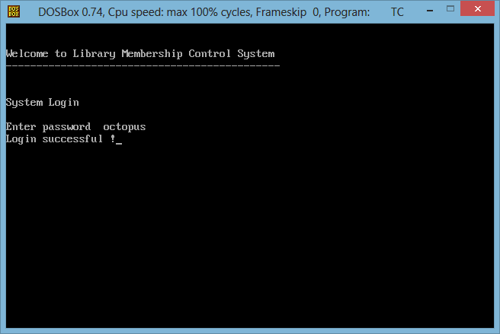
Login Screen

Slide 9
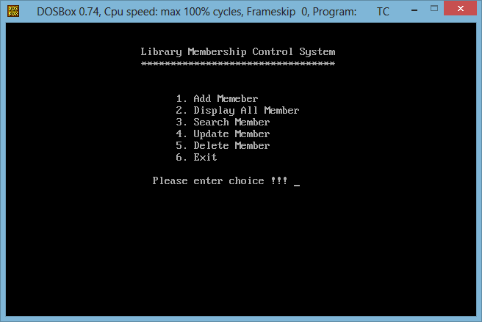
Main Menu Screen

Slide 10
CONCLUSION
Program Strengths
It is a security enabled system with many data validation checks such as fixed limit characters restrictions and maximum characters limits and date format restrictions and data duplication check for ID field and controlled by many error and information messages to guide users to type in valid data information.
Program Weaknesses
The main weakness of the program is that it cannot validate whether the user types in an alphabetic or a digit. And the password is set by the system and they cannot be changed.
Program Enhancements
In the future version of the program, validating checks for alphabetic or digit and change password function will be included and some functions will be expected to be improved.

